Slide 1


S.H.E.L.L
HACKING CLUB OF VNIT

Slide 2
Who Are We ?
Secure Hack Exploit and Learn with Linux aka S.H.E.L.L is the ethical hacking club of VNIT.
We at S.H.E.L.L. unravel numerous mysteries as we guide our colleagues through various challenges to build a secure future. Buckle up as we ride down the lanes leading us right from the basics of Linux commands to Pwning executables. We host workshops and participate in Capture The Flags to demonstrate and enhance our understanding.
Security is an illusion;
And we are the illusionists.

Slide 3
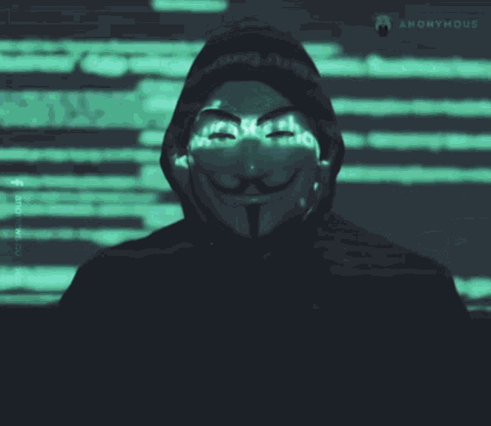
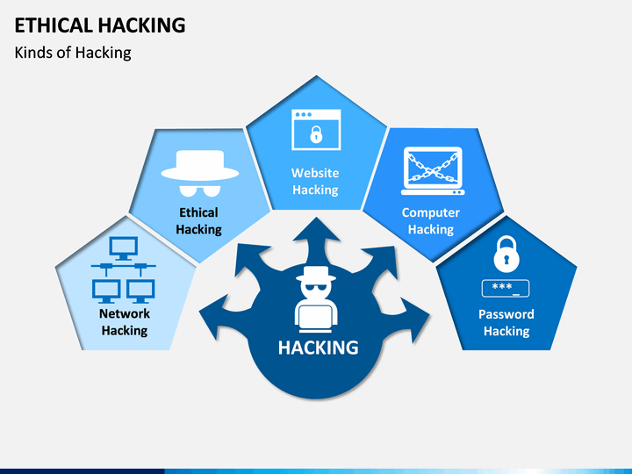
What is Ethical Hacking ?
Hacking is an art of identifying weaknesses in computer systems or a network to exploit the security and gain access to personal data of a individual or a corporation.
Accessing someone’s data without their permission is a criminal offence. Corporates often hires individuals to find vulnerabilities in their system which is legal .

Slide 4

Why should one hack?
In last few years ,cyber threats have been increased which has inflict damages totaling $6 trillion USD globally in 2021.Number of Corporations take security lightly which results
in paying ransomware to cybercriminals . As a result, there are more than 3.5 million (350 % as compared to 8 years ago) jobs vacant in cybersecurity and predicted to boom by 2025.

Slide 5
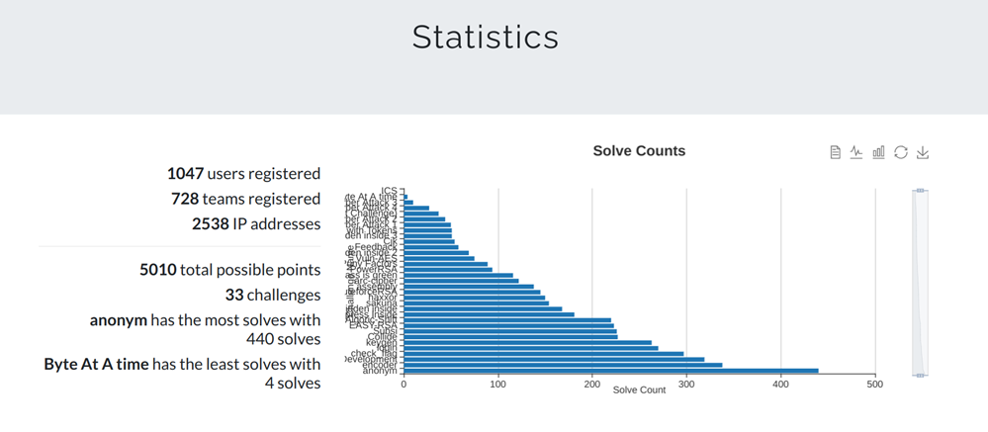


Events organised by us
Workshops on different topics of cybersecurity.
SHELLCTF 2021, A Jeopardy Style CTF-event.
Sponsors

Slide 6
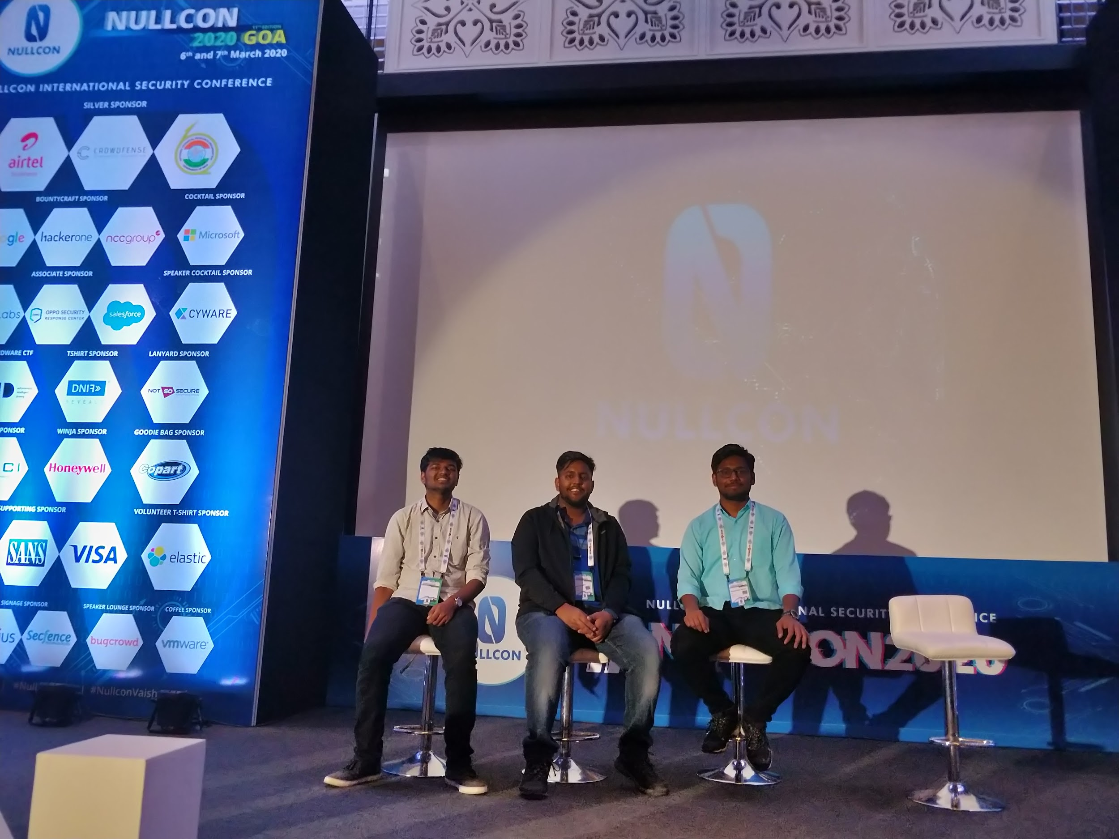

Conferences
Notes:
Apart from participating in international Capture the Flag competitions as a team, our members also get a chance to attend International conferences on Cybersecurity. A one of a kind experience to meet and learn from some extremely talented people in the cybersecurity community. During this we got the opportunity to interact with the Airtel security team, Mr. IoT, Arun Mane, Vivek Ramachandran, Jay Turla, BiOS, Payatu Labs and many renowned security researchers.

Slide 7


How We Learn & Practice
wh
We learn through various courses by great cyber security specialists like TCM
We use platforms like
TryHackMe Hack The Box

Slide 8
Categories
Linux Fundamentals.
Bash scripting & Python.
Web exploitation.
Cryptography.
Reverse Engineering & Binary Exploitation.
Forensics

Slide 9
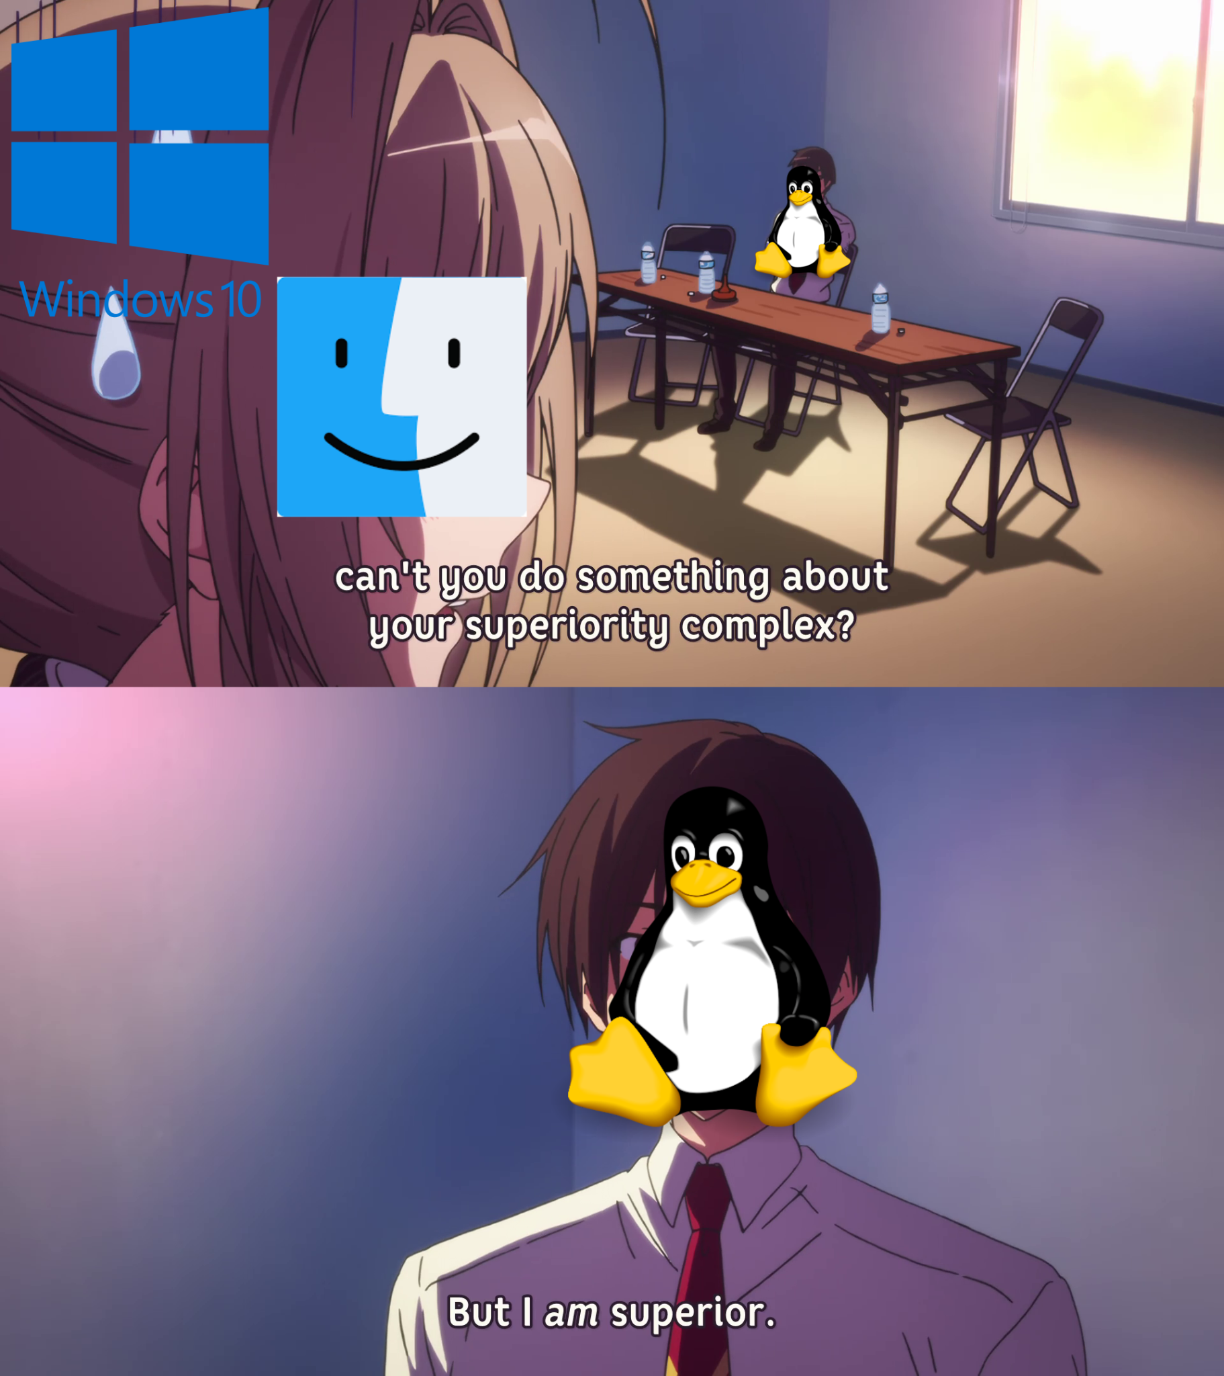
Linux Fundamentals
Linux is a family of open-source operating systems based on the Linux kernel, an operating system kernel first released on September 17, 1991.
Linux has several distros like ubuntu,kali,arch etc, each providing different features and functionalities.
Linux being open source,and having low
requirements make it superior than
others.

Slide 10
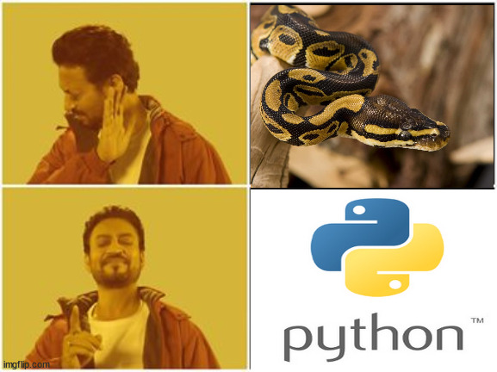
Bash scripting and Python
If you want to write same bunch of codes or commands again and again it would be a tedious task. to remove this tedious labour work we wire python scripts and exploits in bash and reuse it as and when needed.
This skill is useful in every category of hacking, helps you perform a particular task while not appearing suspicious to the Security of the system.

Slide 11


Web
First of all web is a category of cyber security which deals with security of web application (Web application are nothing but website google,facebook,shopping sites, bank sites all comes in web). These vulnerabilities may exist in login form, search bar in various sites, user profile sections, photo/upload options, etc.
Ig everyone is familiar with this search bar.
There existed an XSS vulnerability as a result google paid $1000 for person who found this bug.
Next Big software Giant , there existe vulnerability in authentication mechanism, this bug gave ability to fully controller more 1 billion users of it. Team who found was awarded with $15,000 bounty
Notes:
what we deal with - server side attacker should not be able withdraw data , client side that client receive valid and correct data from server
what are web application ? - web apps are nothing but the websites that we use in day to day life like google,etc that is over internet
where vulnerability exist
Popular searchbar
auth mech

Slide 12
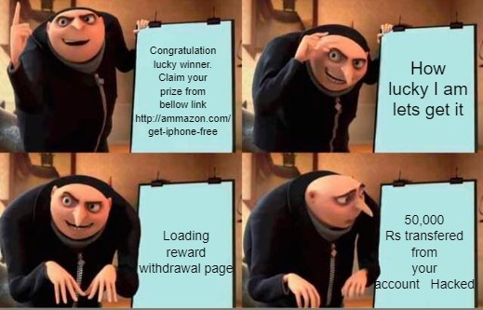
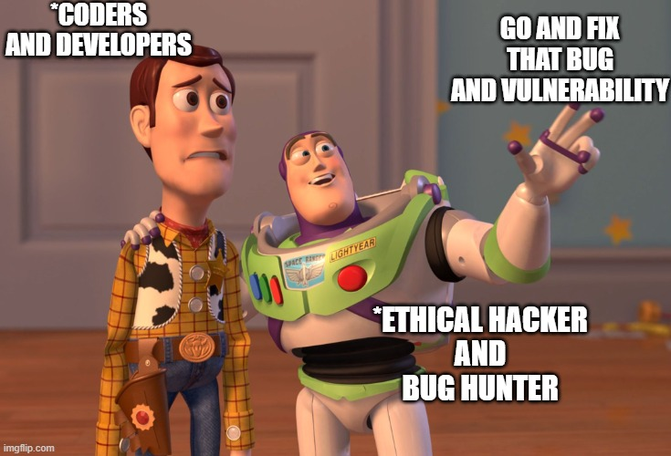
SCAM
What Ethical Hackers do in web security
Notes:
All the news that we hear now days about data breaches and online frauds of clicking a link and bankrupt are all caused due to not properly developing web sites and web application. Like say a vulnerability exist in amazon and attacker sends a crafted thing with malicious script in it under say that you want a gift prize , we click it and we are bankrupt now , who would like to be bankrupt due to an ecommerce site, its insane.
So, there exist countless of vulnerabilities in web application. Coders and Developers makes web application and Ethical Hackers test then and try to exploit bad coding practice and send programmer back to drawing board to re-write and improve it. Before any application or website is made available to common people it goes through countless number of cyber security specialist and then through bug-bounty platforms were hackers other than companies workers try to find mistakes and bugs in it and get paid for finding one.

Slide 13
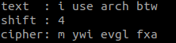
Cryptography
Cryptography is a technique which converts a plain text into unintelligible text such that no unauthorized person can understand it.
Job of ethical hacker is to make sure that the algorithm or how we are encrypting the data is not easily breakable with any computational power of our computers.
Caesar Cipher
Notes:
The category which I study is cryptography so what does cryptography means if we have any plaintext or data which we want to encrypt for secure communication such that no unauthorized person can read it
The important task for an ethical hacker is to make such algorithm which is not easily breakable by any computational powers of our computers
Let me give you an example of Caesar cipher in this we we encrypt the text attack at once by shift of 4 like A is shifted by 4 and we get letter E similarly it used in on the whole text and we get this encrypted text as cipher
This is not an good encryption technique because it's easily breakable

Slide 14
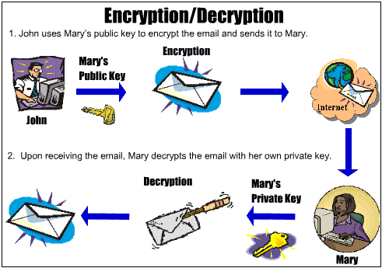
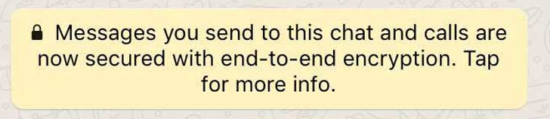

Real Life Examples
Notes:
Now some examples in which cryptography is used
The first one is the email encryption where the text is encrypted using a key which is secret between the sender and the receiver side the second example is well known to us which is used in whatsapp that is end to end encryption
The third is emoney for example crypto currency like bitcoins which need to be secured using cryptography techniques

Slide 15

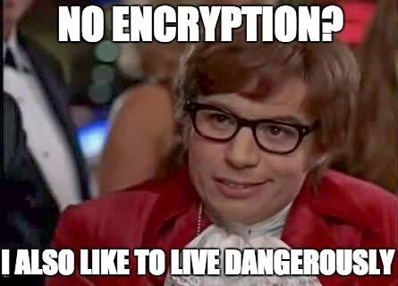
Notes:
Now what we a cryptographic expert we take data which is encoded and try to decode it to check strength of it
And other way if you think you are vin Diesel who don't need any secure password then perhaps you need to rethink because the encryption could be easily breakable

Slide 16
Reverse Engineering and
Binary Exploitation
Reverse engineering (or reversing) involves taking an executable and figuring out the underlying algorithm/software behind it. Useful for finding the purpose of suspicious executables, recovering lost documentation etc.
Binary exploitation (or pwning) works on the principle of turning a weakness into an advantage. It involves finding a vulnerability in the program and exploiting it to gain control of a shell or modifying the program’s functions.

Slide 17
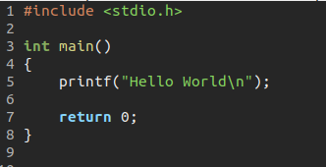
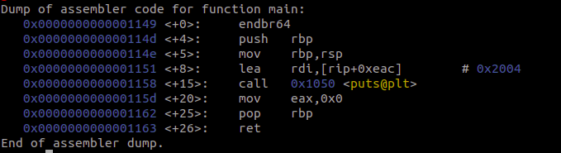
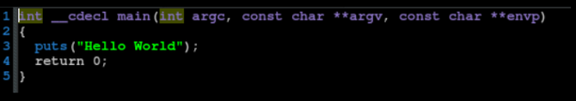
A basic program
Disassembled exe
Decompiled exe

Slide 18
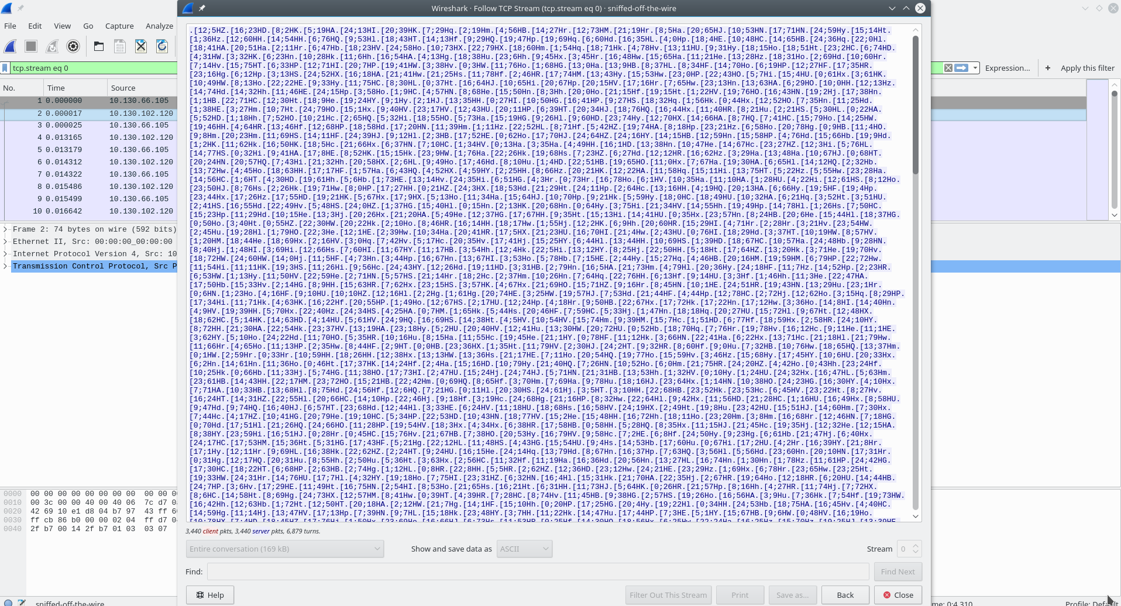
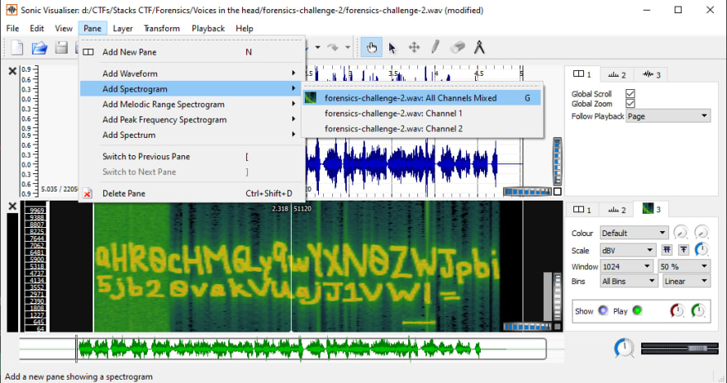
Forensics
A field which resembles the working style of Sherlock Holmes. You actually have to dig into things using various tools.
It has many subdomains like:
Image forensics ,Data forensics,file format analysis , steganography, memory dump analysis, network capture analysis etc.

Slide 19




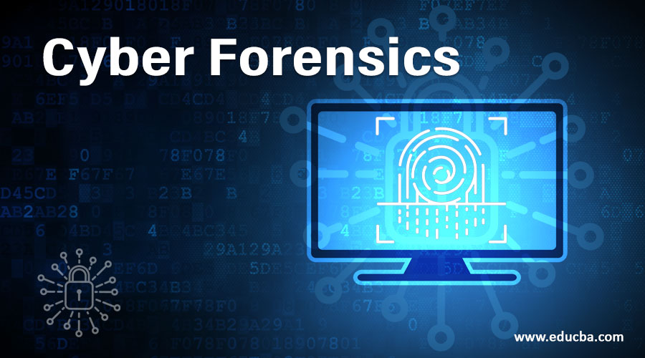
Notes:
click to add speaker notes

Slide 20
How to join shell?
We will learn about all fields of cyber-security in depth
01
Workshop
Here you need to apply the concepts you learned in workshops and solve challenges in CTF
SHELL CTF 2022
02
After the CTF, you will be interviewed
03
Interview
Notes:
So how can you join S.H.E.L.L
first we are going to conduct workshops to make you familiar with the basics required for cybersecurity and ctfs
after that we are going to organize SHELL CTF 2022 in which you have to participate and based on your performance in ctf we are going to arrange interview for you

Slide 21




Where you can find us
https://medium.com/shellpwn
https://github.com/S-H-E-L-L
https://ctftime.org/team/65394/
https://in.linkedin.com/company/shell-vnit
Notes:
You can find us on these websites

Slide 22
Achievements
Attempted numerous CTFs all around the year
32nd rank in INCTF Nationals .
28th in India , 434th worldwide on CTFTime.
Attended NULLCON 2019CIA Conference ( CIACON),
HITBCyberWeek, DCS2020, Hardwear.io
Red Team Village,C0c0nv 2020, Hack the
Capitol 3.0, ICS Security Riscure Hybrid
Workshop, TryHackCIT Virtual
Cybersecurity Bootcamp, CTF
Hackoverflow, ICS Village and so on.
Notes:
What we have achieved till now we have attempted various ctf throughout the year the

Slide 23

Any Questions ?
Notes:
If you have any questions about us you can ask now

Slide 24

Are you ready for the thrill?

Slide 25
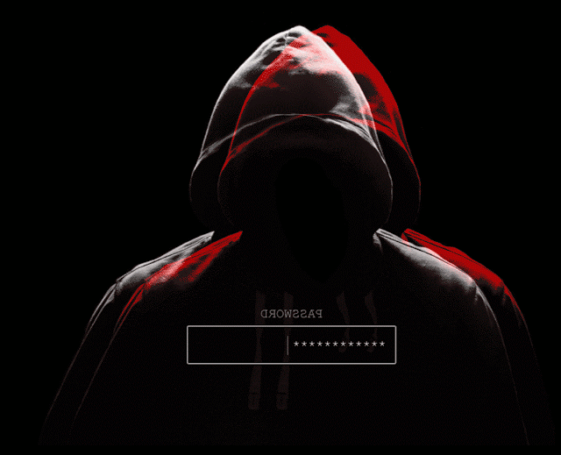
Thank You
Keep Hacking…
Notes:
Thank You for joining our orientation and keep hacking

